Slide 1



Credit Card Fraud Detection using Machine Learning and Data Science
Course: Research Methodology
Section: E

Slide 2
Group Members
01
TONMOY DEY
ID: 20-44206-3
Serial: 30
02
SHOWMITRA ROY
ID: 20-44208-3
Serial: 31
03
ABDUL MUNIM ADNAN
ID: 20-44213-3
Serial: 32
04
ASIF AHMED TANJID
ID: 20-44249-3
Serial: 35
05
06
SUNJIDA KABIR SHEPA
ID: 20-44263-3
Serial: 37
MD. HAJJAJ BIN SONOSI
ID: 20-44346-3
Serial: 38

Slide 3


Table of Contents
Introduction
Background Study
Problem Statement
Objective (GENERAL & SPECIFIC)
Contribution of the study
Literature Review
Research Methodology In Flowchart
Schedule and Budget
Data Collection Method
Significant of the Study
References

Slide 4

INTRODUCTION
What is Credit card fraud?
Credit card fraud is a type of financial fraud that occurs when a stolen or forged credit card is used to make unauthorized purchases or transactions.

Slide 5

INTRODUCTION
how data science and machine learning can be helpful for it?
help gather more information faster or to assist with trends analysis.
One common machine learning approach is to use supervised learning algorithms.

Slide 6

Background Study
Machine learning offers a more advanced approach
traditional detection methods such as manual review and rule-based systems
Machine learning algorithms can process vast amounts of data in real-time, allowing for quick adaptation to new threats and the detection of fraudulent transactions.

Slide 7
Problem Statement
Credit card fraud detection using machine learning and data science requires balancing accuracy and false positives.
False positives harm customer experience and false negatives lead to financial losses.
Financial institutions must process high volumes of transactional data in real-time, requiring efficient machine learning algorithms.

Slide 8
Problem Statement
Fraudsters constantly evolve their tactics, requiring regular model updates and improvements.
Data science techniques, like feature selection, identify patterns and anomalies in transactional data.
Ongoing research and development is necessary to keep up with evolving fraud tactics.
A multi-faceted approach is required for fraud detection, including continuous improvement of models, efficient machine learning algorithms, and consideration of the accuracy and cost trade-off.

Slide 9
Objectives
General objectives:
Predictive model
Accurately identify fraudulent transactions
Credit card dataset
Minimize false positives
SPECIFIC OBJECTIVES:
DATA COLLECTION
DATA PREPROCESSING
FEATURE ENGINEERING
MODEL SELECTION
MODEL EVALUATION
MODEL DEPLOYMENT
MONITORING AND MAINTAINENCE

Slide 10
Contribution of the study
Development of more effective and efficient fraud detection systems
Minimizing financial losses due to credit card fraud
Better protection for customers and reduced financial risks for financial institutions
Development of more accurate and robust machine learning algorithms and data science techniques
Application to other domains beyond credit card fraud detection, such as insurance fraud or healthcare
Raising awareness of data privacy and security
Promotion of interdisciplinary research and collaboration between experts in machine learning, data science, and finance.

Slide 11
Literature Review
Description: | Citations:
One of the earliest studies in this area was conducted by Nathalie Japkowicz and Stephen S. Hailpern in 2002 [1]. The study explored the use of machine learning techniques, including decision trees and neural networks, to detect credit card fraud. The authors used a dataset containing 5,000 credit card transactions, of which 1.5% were fraudulent. The results showed that the decision tree algorithm was the most effective at detecting fraud, achieving an accuracy of 91.5%. | [1] Japkowicz, N., & Hailpern, S. S. (2002). Credit card fraud detection using cost-sensitive neural networks. In Proceedings of the International Conference on Machine Learning (ICML) (Vol. 217, pp. 267-274).

Slide 12
Literature Review
Description: | Citations:
Since then, numerous studies have explored various machine learning techniques for credit card fraud detection, including supervised and unsupervised learning algorithms. In a 2015 study, Karim et al. [2] compared the performance of four supervised learning algorithms, including logistic regression, decision trees, support vector machines, and neural networks, on a dataset containing over 28,000 credit card transactions. The results showed that the neural network algorithm outperformed the other algorithms, achieving an accuracy of 98.8%. | [2] Karim, A., Rahman, M. A., & Islam, M. M. (2015). Credit card fraud detection using neural network. International Journal of Computer Applications, 111(4), 25-32.

Slide 13

Research Methodology In Flowchart

Slide 14
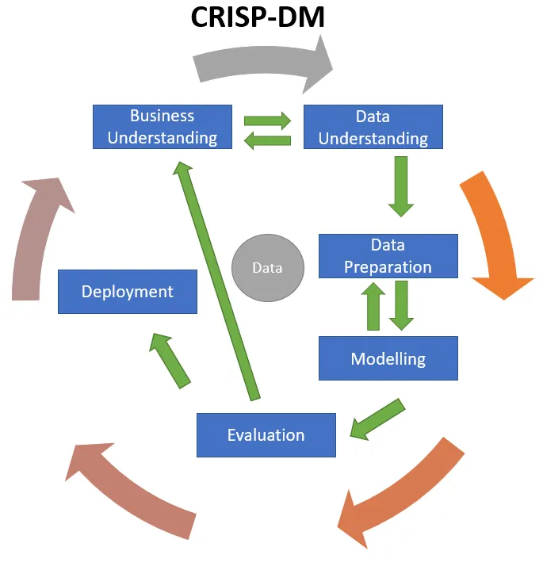
System Development Methodology
The system development methodology chosen for credit card fraud detection using machine learning and data science is the CRISP-DM (Cross-Industry Standard Process for Data Mining) methodology.

Slide 15

Justification of Selection
Widely Used
Flexibility
Structured Approach
Focus on Business Objectives

Slide 16
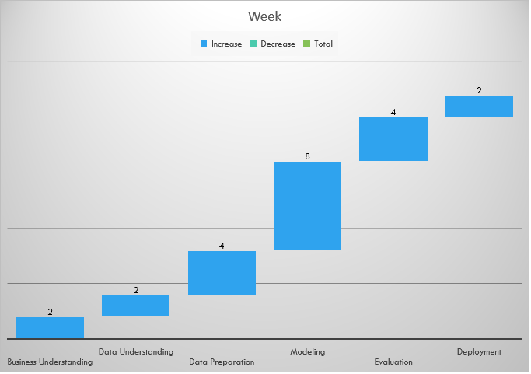
Schedule and Budget
Schedule:
Approximate Budget:
Personnel: $100,000
Hardware and Software: $50,000
Data Acquisition and Preparation: $25,000
Model Development and Testing: $75,000
Deployment and Maintenance: $25,000
Total project budget: $275,000
Total project duration: 22 weeks (5.5 months)

Slide 17
Data Collection Method
Surveys and Questionnaires
Interviews
Observations
Records and Documents

Slide 18
Data Collection Method
Surveys and Questionnaires:
In its most basic form, surveys and questionnaires serve as a way to collect information from specific respondents with the intention of extrapolating the findings to a larger audience. To gather reliable data and insights from their target audience, almost everyone involved in data collecting, particularly in the business and academic sectors, relies on surveys and questionnaires.

Slide 19
Data Collection Method
Interviews:
A proper definition of an interview is a formal encounter between two people during which the interviewer probes the interviewee to learn more. An interview allows you to learn about a person's other talents in addition to gathering personal information about them.

Slide 20
Data Collection Method
Records & Documents:
The observation method of data collection involves seeing people in a certain setting or place at a specific time and day. Essentially, researchers study the behavior of the individuals or surroundings in which they are analyzing. This can be controlled, spontaneous, or participant-based research.

Slide 21
Data Collection Method
Records & Documents:
This data collection method involves analyzing an organization’s existing records and documents to track or project substantial changes over a specific time period. The data may include the following:
Email logs
Staff reports
Call logs
Databases
Information logs
Minutes of meetings

Slide 22
Significant of the Study
The development of a credit card fraud detection system using machine learning and data science techniques has significant implications for the financial industry and society. Credit card fraud is a significant problem that costs billions of dollars each year. By developing a robust and accurate fraud detection system, financial institutions can reduce their losses and protect their customers' finances. Credit card fraud can lead to a loss of trust between customers and financial institutions.

Slide 23
References
[1] Japkowicz, N., & Hailpern, S. S. (2002). Credit card fraud detection using cost-sensitive neural networks. In Proceedings of the International Conference on Machine Learning (ICML) (Vol. 217, pp. 267-274).
[2] Karim, A., Rahman, M. A., & Islam, M. M. (2015). Credit card fraud detection using neural network. International Journal of Computer Applications, 111(4), 25-32.
[3] Phua, C., Lee, V., Smith-Miles, K., & Gayler, R. (2010). A comprehensive survey of data mining-based fraud detection research. Artificial Intelligence Review, 33(3), 229-246.
[4] Ahn, Y. Y., Kwak, H., Moon, S., & Lee, S. (2018). Credit card fraud detection using clustering with outlier detection. Expert Systems with Applications, 94, 23-34.
[5] Agarwal, D., Zhou, X., & Krishnan, N. C. (2016). Hybrid ensemble approach for credit card fraud detection. Expert Systems with Applications, 46, 315-324.
[6] Shi, L., Yang, X., Zhang, J., & Chen, Q. (2019). Deep learning for credit card fraud detection. Neural Computing and Applications, 31(4), 955-963.

Slide 24

Thank You

